Slide 1


Prepared by Yuqing Chen, Heejae Roh
Nikshita Ranganathan, Archit Barua
Professor Paromita Guha
Feb 14th, 2023
BANK CUSTOMER
CHURN

Slide 2


What factors do you think drives the bank churn?
ⓘ Start presenting to display the poll results on this slide.
Notes:
Less online service/ Better service/ interest rates/ Customized Credit card/ Customer Care/

Slide 3
Which customer segments are most likely to churn?
ⓘ Start presenting to display the poll results on this slide.

Slide 4
What strategies will you recommend to increase customer loyalty?
ⓘ Start presenting to display the poll results on this slide.

Slide 5

”
“Churn butter, not customers!”

Slide 6





COLLECTING DATA
DATA CLEANING
BANK
CUSTOMER
CHURN
EDA
HYPOTHESIS TESTING
REGRESSION MODEL
DECISION TREE

Slide 7





PRIMARY QUESTIONS
Main Factors affecting churn?
Customer Segments most affected?
Effective Strategies to reduce churn?
Best Methods make loyalty & engagement?

Slide 8


UNDERSTANDING THE DATASET
Exited = Target Variable
Contains details of 10,000 customers & 14 features
Customer's demographics, financial status, & banking behavior
7 categorical, 1 character and 6 numerical variables
Descriptive statistics

Slide 9

DATA CLEANING AND MANIPULATION
01
03
05
Changing column names
Dropping & Adding column
Checking for NA/null values and Duplicate rows
Recoding columns
Modifying the datatypes
02
04

Slide 10

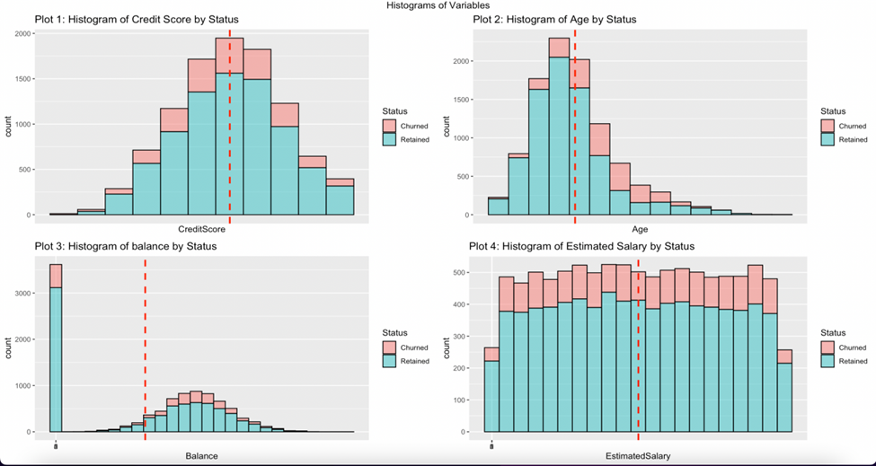




HISTOGRAMS
Part1
Analysis
EDA
Credit score - Normally distributed
Average score of 650
Age - Right skewed
Balance - Normal distribution except
zero
Estimated salary - Uniform distribution
Mean of 100k

Slide 11
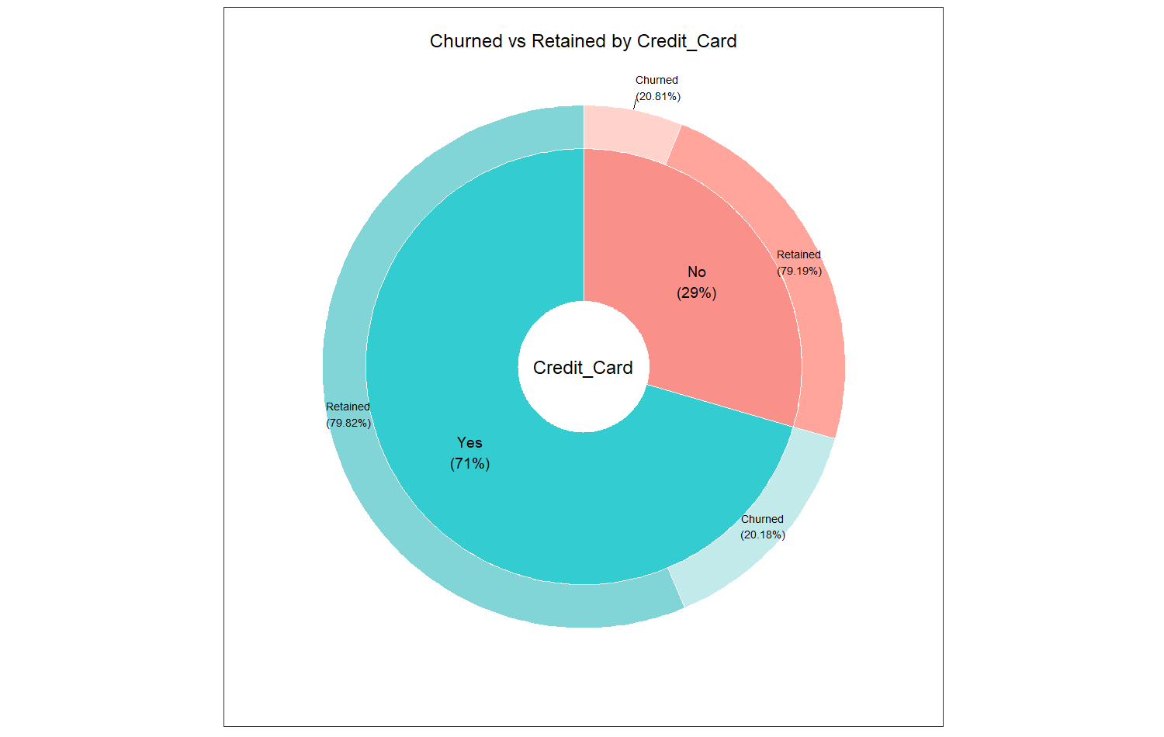
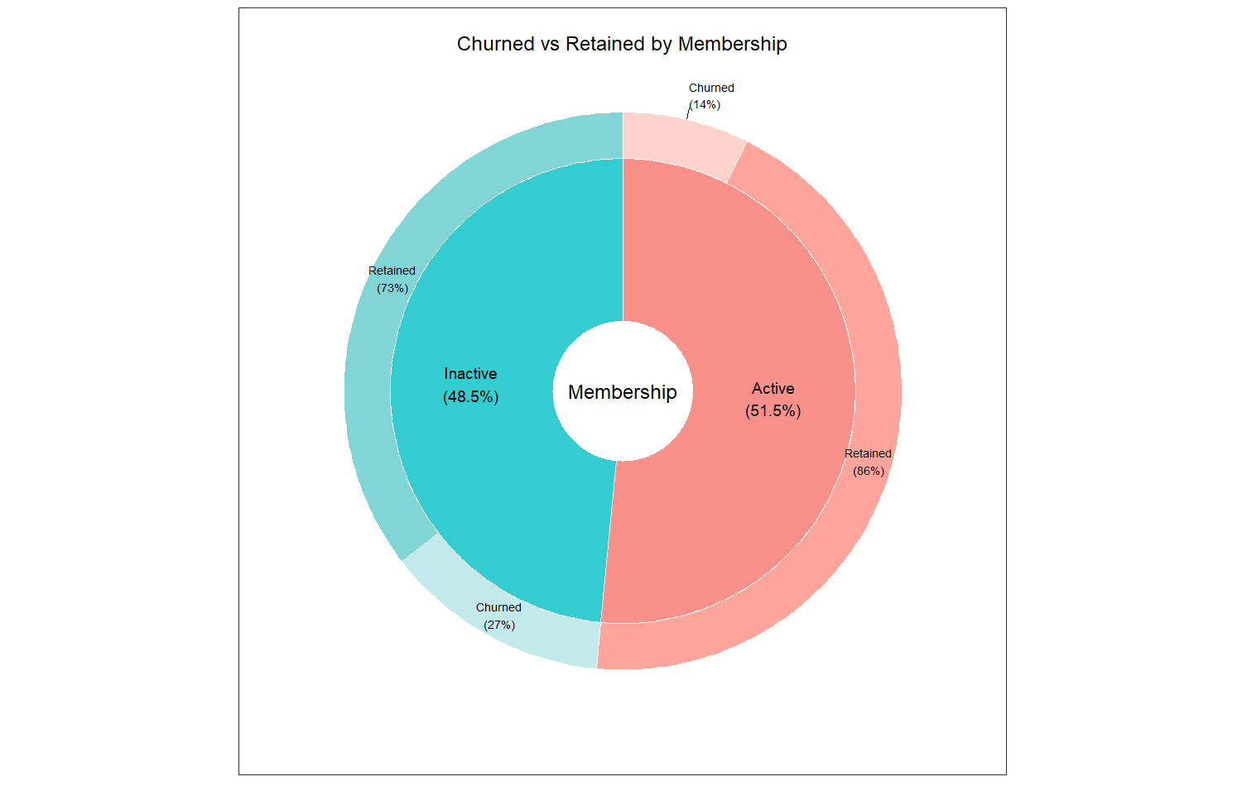


DONUT PIE CHARTS
Part3
Part1
Analysis
Analysis
EDA
Credit cards do not have a significant effect on churn rate
Membership status is an important factor in customer retention.

Slide 12
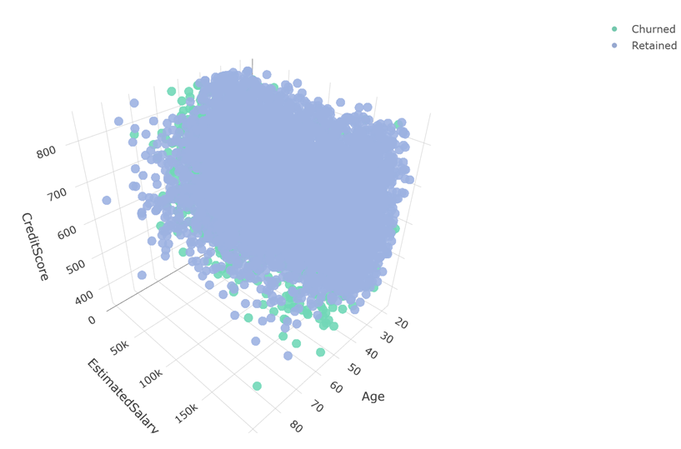

3D PLOT
Part3
Part1
Analysis
Analysis
EDA
Relationship between
Credit score, Salary & Age.

Slide 13

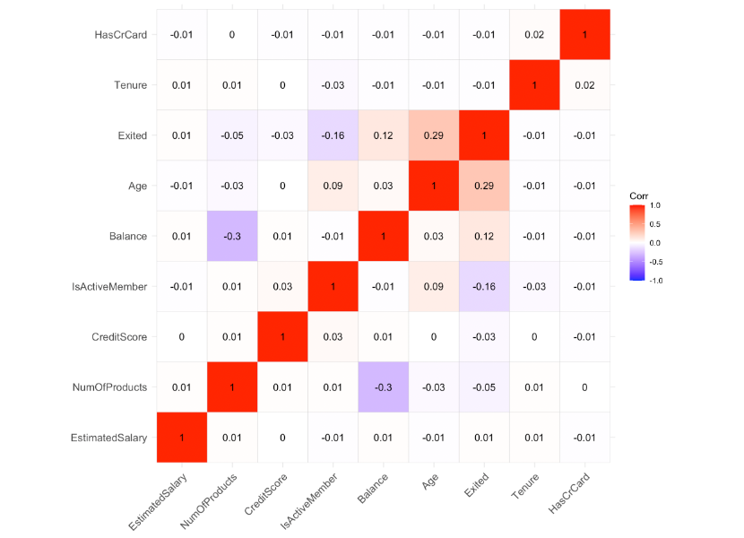
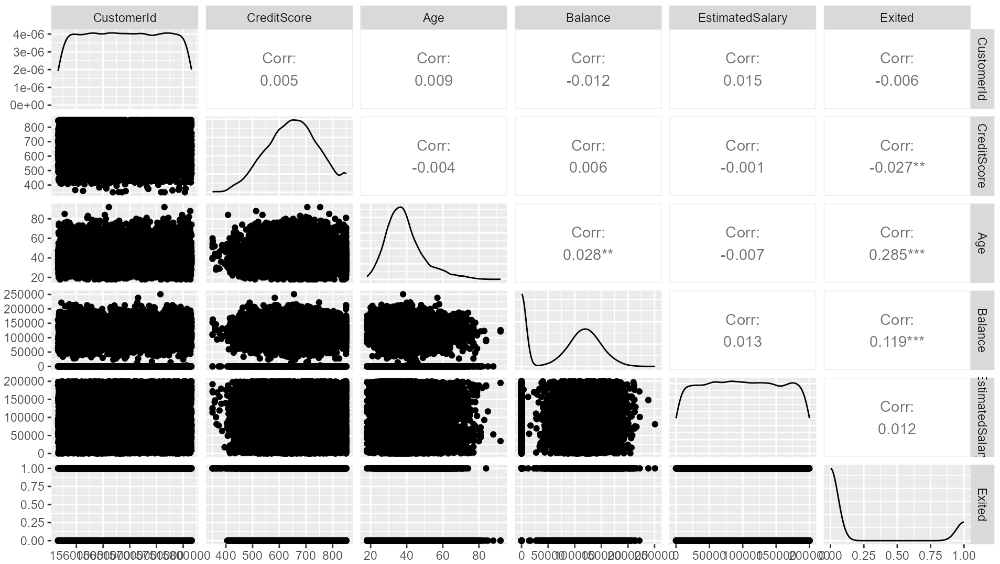
CORRELATION
Part3
Part1
Analysis
Analysis
EDA
Exited column is most correlated
with CreditScore, Age, and Balance

Slide 14


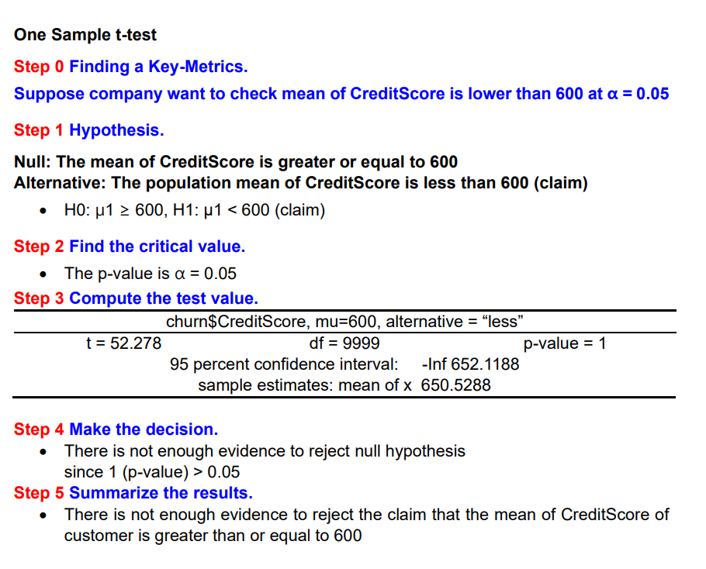

One Sample t-test
Part3
Part2
Analysis
Analysis
Hypothesis
STEP 0 Finding a Key Metrics
Step 4 Make the decision
H1,
claim
There is not enough evidence
to reject null hypothesis
since 1 (p-value) > 0.05
600
Credit Score
Step 5 Summarize Results
H0
Credit Score
600
Notes:
https://www.free-power-point-templates.com/articles/how-to-create-sticky-note-pictures-using-powerpoint-2010-and-shapes/

Slide 15




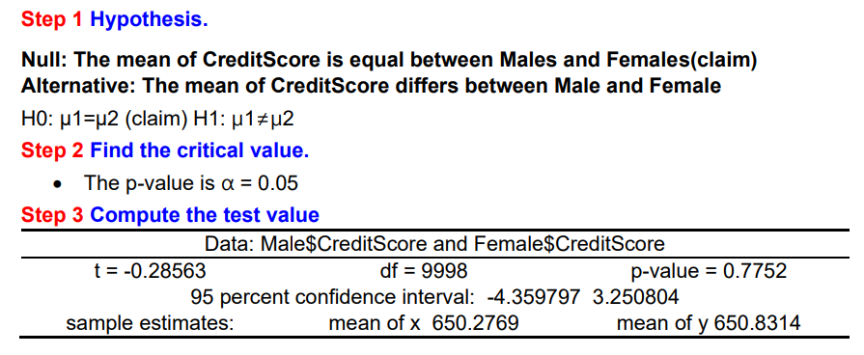
Two Sample t-test
Part3
Part3
Part2
Analysis
Analysis
Analysis
Hypothesis
STEP 0 Finding a Key Metrics
Step 4 Make the decision
H0,
claim
There is not enough evidence
to reject null hypothesis
since 0.7752 (p-value) > 0.05
Credit Score by Gender
Step 5 Summarize Results
H0
Credit Score by Gender

Slide 16


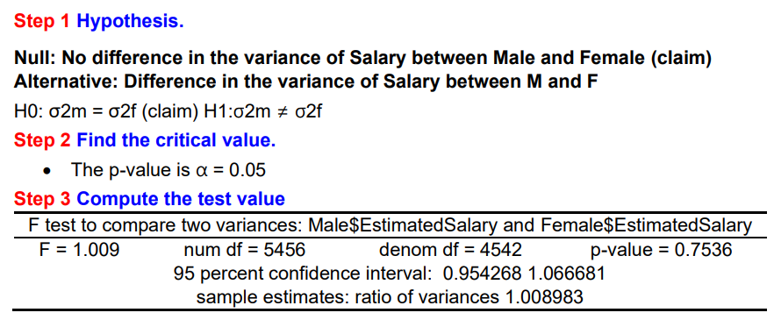

F-test
Part3
Part3
Part2
Analysis
Analysis
Analysis
Hypothesis
STEP 0 Finding a Key Metrics
Step 4 Make the decision
H0,
claim
There is not enough evidence
to reject null hypothesis
since 0.7536 (p-value) > 0.05
Salary Var. by Gender
Step 5 Summarize Results
H0
Salary Var. by Gender

Slide 17




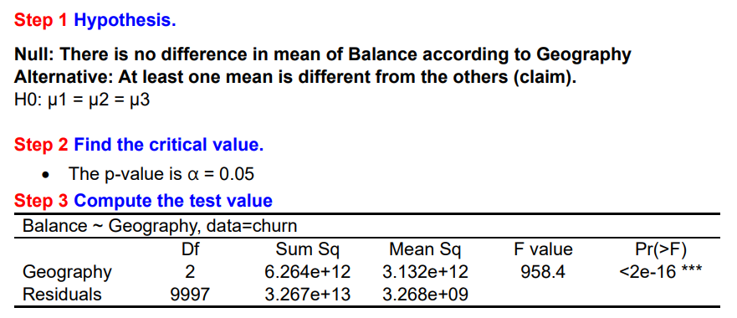

One-way ANOVA
Part3
Part3
Part2
Analysis
Analysis
Analysis
Hypothesis
STEP 0 Finding a Key Metrics
Step 4 Make the decision
?
?
There is enough evidence to
reject null hypothesis
since 2e-16 (p-value) < 0.05
H1
Spain France Germany
H1,
claim
Balance by Geography
Step 5 Summarize Results
Spain France Germany
Balance by Geography

Slide 18
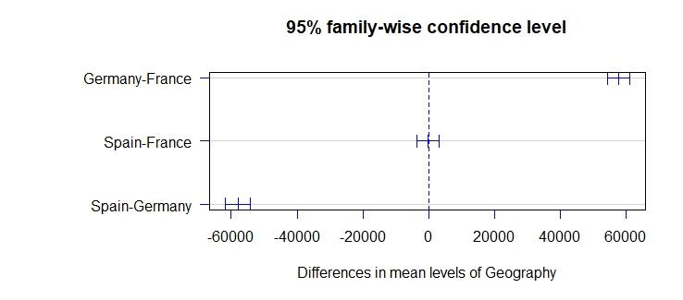

Tukey test
Part3
Part3
Part2
Analysis
Analysis
Analysis
Hypothesis
Results

Slide 19
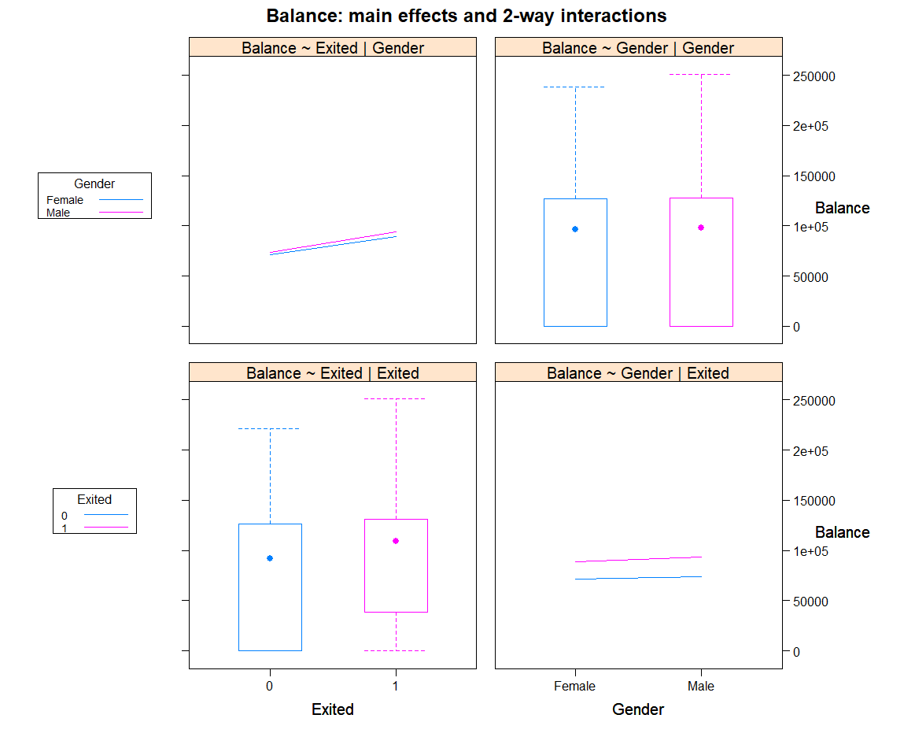

Two-way ANOVA
Part3
Part3
Part2
Analysis
Analysis
Analysis
Hypothesis
H0
0.52
H1
0.0123 *
STEP 0 Finding a Key Metrics
H0,
claim
Balance
x
H1
<2e-16 ***
H0
0.52
Gender
Churn

Slide 20
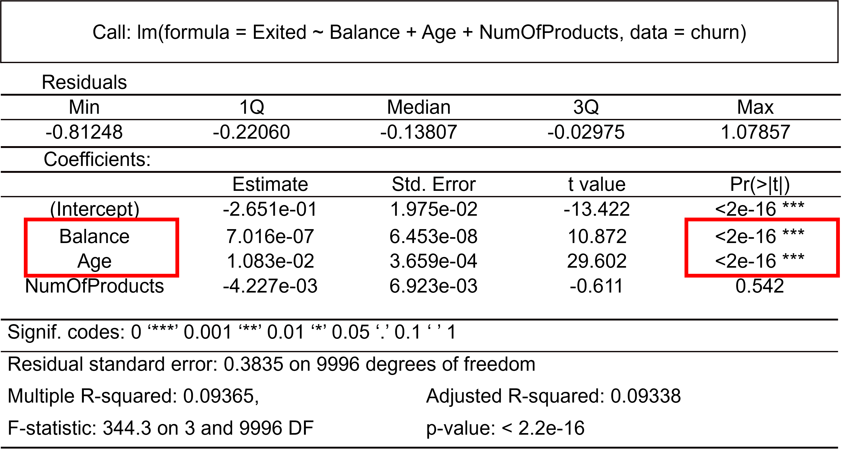


Linear Regression
Part3
Part3
Analysis
Analysis
Regression
CUSTOMER
CHURN
BINARY

Slide 21
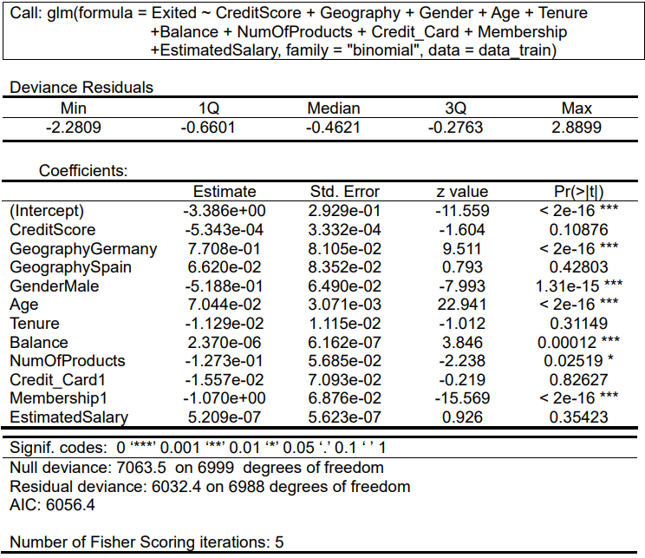
Logistic Regression- Model 1
Part3
Part3
Analysis
Analysis
Regression
Several variables in the logistic regression model are statistically significant at the 5% level, indicated by the "***" in the Pr(>|z|) column.
The statistically significant variables include CreditScore, Geography (specifically Germany), Gender, Age, Balance, and Membership (specifically Inactive).
Variables with p-values greater than 0.05 are not statistically significant, which means that their effect on the outcome is not significant enough to be distinguished from chance alone.
The variables with p-values greater than 0.05 in this model are NumOfProducts, Credit_Card, and estimated salary.
.

Slide 22
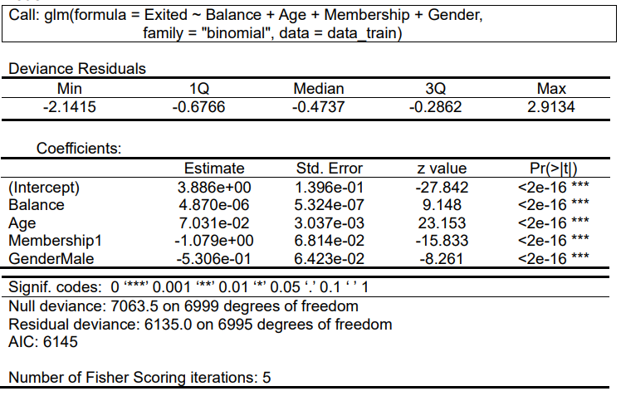
Logistic Regression- Model 2
Part3
Part3
Analysis
Analysis
Regression
There are trade-offs to consider when comparing the two models: the first model with all the predictors has a lower residual deviance and lower AIC, indicating a better fit to the data.
However, the second model with fewer predictors may be preferred if the goal is to reduce the number of predictors in the model or to simplify interpretation.
The second model may be easier to interpret because it has fewer predictor variables to consider and may be more parsimonious or efficient, especially if some predictors have limited impact on the outcome or are redundant with other predictors.
.

Slide 23
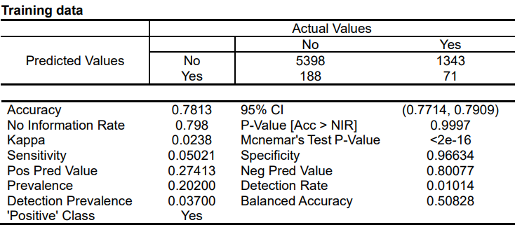
Confusion Matrix- Train
Part3
Part3
Analysis
Analysis
Regression
The model predicted "No" 5,398 times correctly and "Yes" 71 times correctly, but misclassified "No" 1,343 times and "Yes" 188 times.
The overall accuracy of the model is 0.7813, which means it correctly predicted the outcome 78.13% of the time.
The sensitivity of the model is very low, at 0.05021, indicating that the model is not very good at predicting positive cases.
The specificity of the model is high, at 0.96634, meaning that it is good at identifying negative cases.
False negatives would be more damaging in this case, as they represent customers who have actually left the bank, but the model predicted they would not.
.

Slide 24
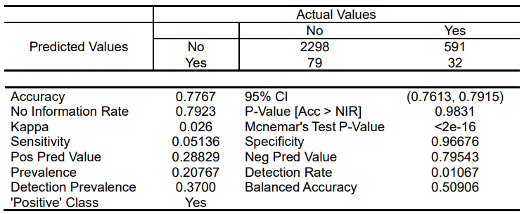
Confusion Matrix- Test
Part3
Part3
Analysis
Analysis
Regression
Out of 3,000 customers in the test data, 2,298 were correctly classified as "No".
591 customers were incorrectly classified as "No", when they actually left the bank.
79 customers were incorrectly classified as "Yes", when they actually did not leave the bank.
32 customers were correctly classified as "Yes".
The accuracy of the classifier is 0.7767, which means that 77.67% of the time, the classifier correctly predicts if a customer will leave the bank or not.

Slide 25
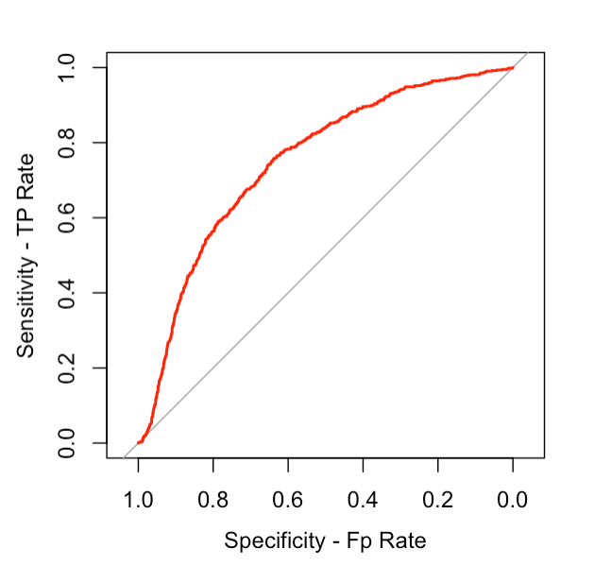
ROC & AUC
Part3
Part3
Analysis
Analysis
Regression
The area under the curve (AUC) is a common metric used to evaluate the performance of binary classifiers.
The AUC value ranges from 0 to 1, where a value of 0.5 indicates that the classifier is performing no better than random chance, while a value of 1 indicates perfect performance.
In this case, the AUC value of 0.7485 suggests that the binary classifier has an average performance in distinguishing between the positive and negative classes.

Slide 26
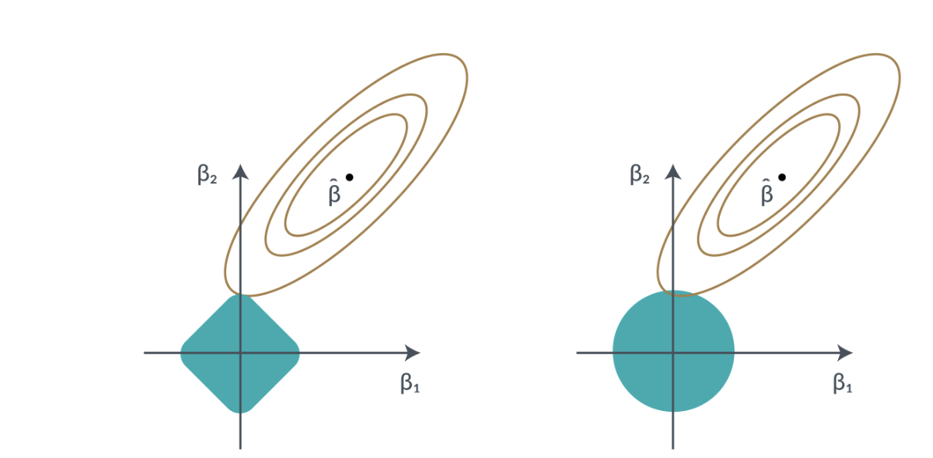

Regularization
Part3
Part3
Analysis
Analysis
Regression
LASSO
Logistic Regression(L1)
penalty = absolute magnitude
May shrink coefficients to zero
contours of RSS
Constraint Function
Ridge
Logistic Regression(L2)
Penalty = square of the magnitude
Shrunk by the same factor.
LASSO
Ridge
Gupta, P. (2017, November 16). Regularization in Machine Learning https://towardsdatascience.com/regularization-in-machine-learning-76441ddcf99a

Slide 27
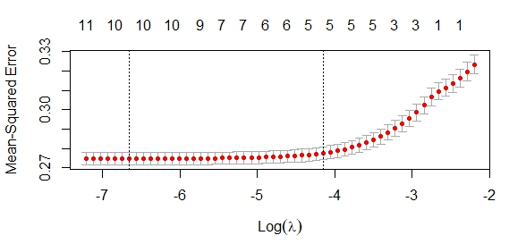


Lasso Logistic Regression
Part3
Part3
Analysis
Analysis
Regression
Left dot line
= minimum lambda
Right dot line
= 1SE of lambda
Red dots
= loss metrics
The Best Lambda
log(λ$min) ① | -6.66026412 | λ$min | 0.00128080
log(λ$1se) ② | -4.14835311 | λ$1se | 0.01579039

Slide 28


Lasso Logistic Regression
Part3
Part3
Analysis
Analysis
Regression
glmnet(x,y= train, alpha = 1, lambda = cv.lasso$lambda.min)
 | Df | %Dev | Lambda
1 | 10 | 14.38 | 0.001281
Minimum
Lambda
= 0.001281
coef(model with min Lambda)
13 x 1 sparse Matrix of class "dgCMatrix" |  | λ$min | 0.00128080
 | s0 |  | s0
(Intercept) | -8.837045e-02 | CreditScore | -6.587130e-05
GeographyGermany | 1.213995e-01 | GeographySpain | 3.299456e-03
GenderMale | -7.108533e-02 | Age | 1.071278e-02
Tenure | -7.654091e-04 | Balance | 2.711338e-07
NumOfProducts | -1.765865e-02 | HasCrCard | .
IsActiveMember | -1.387397e-01 | EstimateSalary | 6.167052e-08

Slide 29






Lasso with 1se of the Min. lambda
Part3
Part3
Analysis
Analysis
Regression
One standard
glmnet(x,y = train, alpha = 1, lambda = cv.lasso$lambda.1se)
 | Df | %Dev | Lambda
1 | 5 | 13.59 | 0.01579
Error
Lambda
= 0.01579
coef(model with 1se Lambda)
13 x 1 sparse Matrix |  | λ$min | 0.01579
 | s0 |  | s0
(Intercept) | -1.1772e-01 | CreditScore | .
GeographyGermany | 9.5137e-02 | GeographySpain | .
GenderMale | -4.3096e-02 | Age | 9.344845e-03
Tenure | . | Balance | 1.661237e-07
NumOfProducts | . | HasCrCard | .
IsActiveMember | -1.0889e-01 | EstimateSalary | .

Slide 30
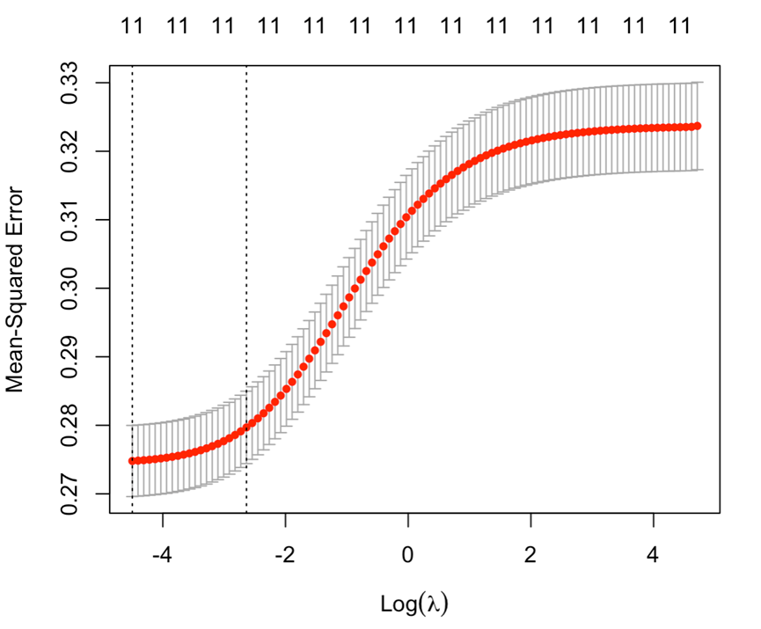
Ridge Logistic Regression
Part3
Part3
Analysis
Analysis
Regression
Left dot line
= minimum lambda
Right dot line
= 1SE of lambda
The Best Lambda
log(λ$min) ① | -4.49722296 | λ$min | 0.01113981
log(λ$1se) ② | -2.63655482 | λ$1se | 0.07160754

Slide 31

Ridge Logistic Regression
Part3
Part3
Analysis
Analysis
Regression
Minimum
glmnet(x,y=train, alpha = 0, lambda = cv.ridge$lambda.min)
 | Df | %Dev | Lambda
1 | 11 | 14.38 | 0.01113981
Lambda
= 0.01113981
coef(model with min Lambda)
13 x 1 sparse Matrix of class "dgCMatrix" |  | λ$min | 0.01113981
 | s0 |  | s0
(Intercept) | -7.3332e-02 | CreditScore | -7.7012e-05
GeographyGermany | 1.2156e-01 | GeographySpain | 6.3492e-03
GenderMale | -7.1908e-02 | Age | 1.0529e-02
Tenure | -1.1684e-03 | Balance | 2.8352e-07
NumOfProducts | -1.9075e-02 | HasCrCard | -7.5599e-04
IsActiveMember | -1.3721e-01 | EstimateSalary | 8.1356e-08
Variables

Slide 32
Ridge with 1se of the Min. lambda
Part3
Part3
Analysis
Analysis
Regression
One standard
glmnet(x,y = train, alpha = 0, lambda = cv.ridge$lambda.1se)
 | Df | %Dev | Lambda
1 | 11 | 14.07 | 0.07160754
Error
Lambda
= 0.07160754
coef(model with 1se Lambda)
13 x 1 sparse Matrix |  | λ$min | 0.07160754
 | s0 |  | s0
(Intercept) | -3.766242e-02 | CreditScore | -6.852981e-05
GeographyGermany | 1.056159e-01 | GeographySpain | 6.888855e-04
GenderMale | -6.390416e-02 | Age | 9.154446e-03
Tenure | -9.792571e-04 | Balance | 2.934445e-07
NumOfProducts | -1.713984e-02 | HasCrCard | -7.200222e-04
IsActiveMember | -1.179581e-01 | EstimateSalary | 6.933143e-08
Variables

Slide 33
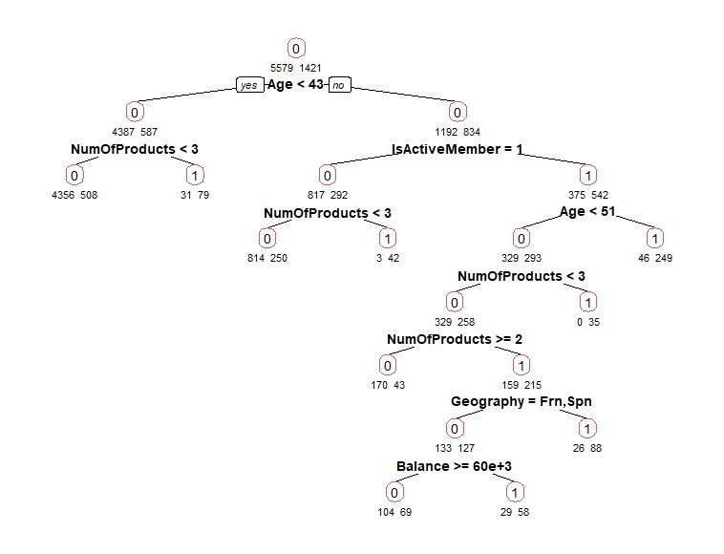
Decision Tree
Part4
Part3
Analysis
Analysis
Decision Tree
1. A decision tree is a visual representation of a decision-making process that uses a tree-like structure to show different possible outcomes or decisions based on a set of criteria or conditions.
2. Each node in the tree represents a question or condition, and the answer leads you to the corresponding branch until you reach a final outcome or decision at the end of a branch.
3. 0= RETAINED 1= CHURNED

Slide 34




Answer for Primary Questions
Part3
Part5
Analysis
Analysis
Conclusion
Main Factors affecting churn?
Customer Segments most affected?
Geography
Gender
Age
Membership
Germany
Male
Age High
No Active
Membership

Slide 35





Answer for Primary Questions
Part3
Part5
Analysis
Analysis
Conclusion
Effective Strategies to reduce churn?
Best Methods make loyalty & engagement?
Using
Personalization
Rewards
& Loyalty program
More
Active
Membership
Improving
Service
Offering
New Products

Slide 36

Q&A
Notes:
https://www.flaticon.com/free-icon/logistic-regression_8003263?term=logistic+regression&page=1&position=4&origin=search&related_id=8003263
https://www.flaticon.com/search?word=decision%20tree

